Slide 1
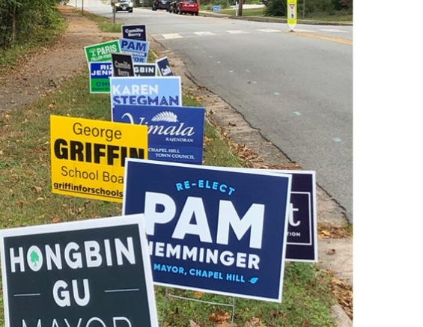
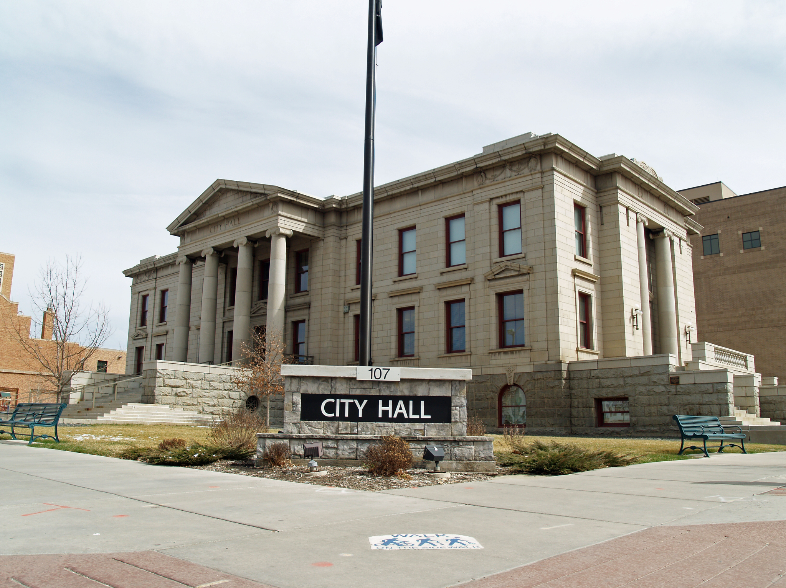
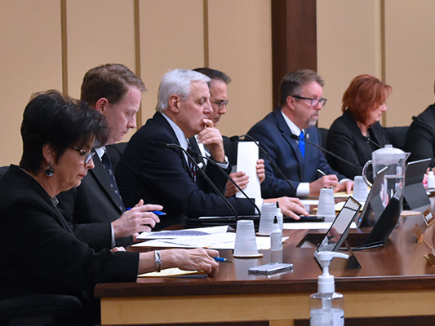
Who Calls the Shots Around Here?
Local Government Classroom Simulations

Slide 2
Close Up Foundation
Close Up is a nonprofit, nonpartisan organization that informs, inspires, and empowers young people to be active and engaged participants in a democracy. Our approach to civic education rests on four key principles:
Issue-Centered Education
Experiential Education
Constructivism
Cooperative Learning

Slide 3
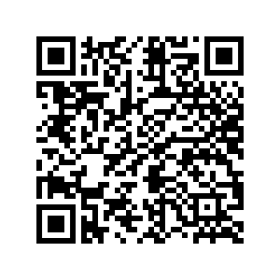
Session Materials
Two Full Local Government Simulation Lesson Plans
Close Up Current Issue Blog Article
Close Up Civic Seal Resources

Slide 4
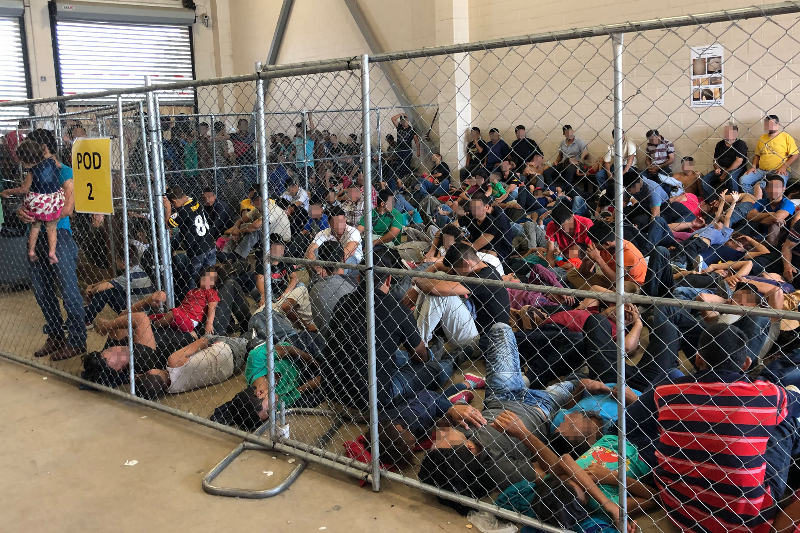
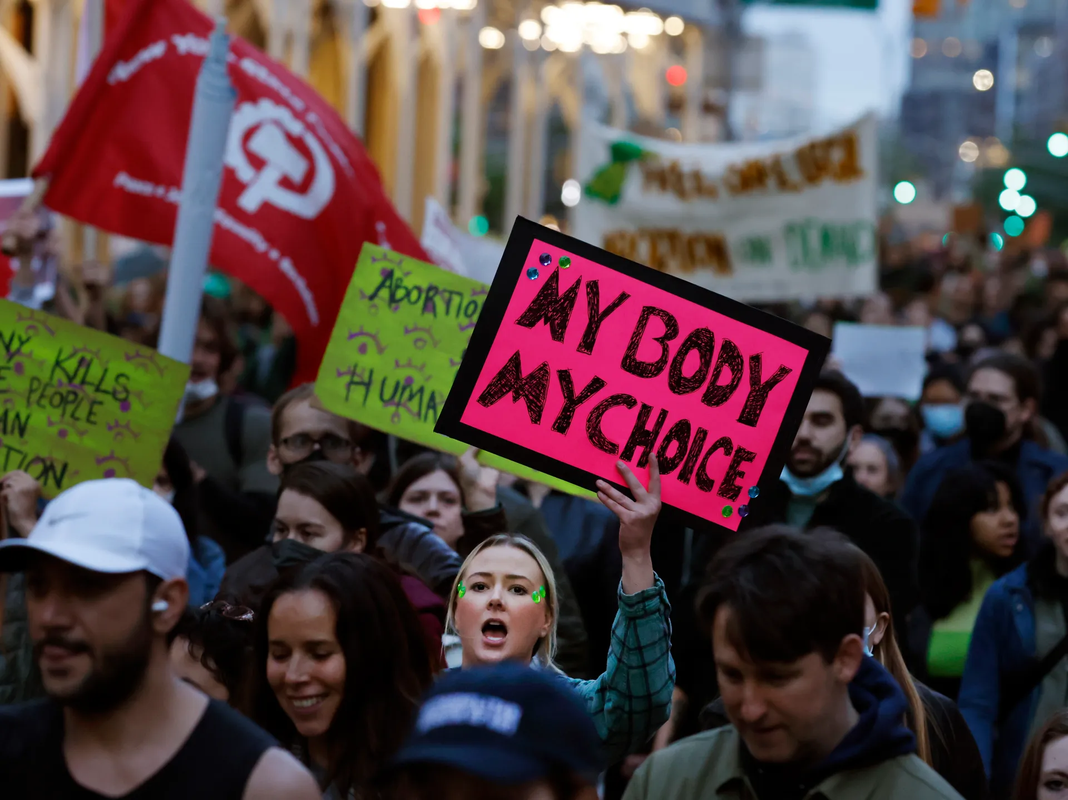
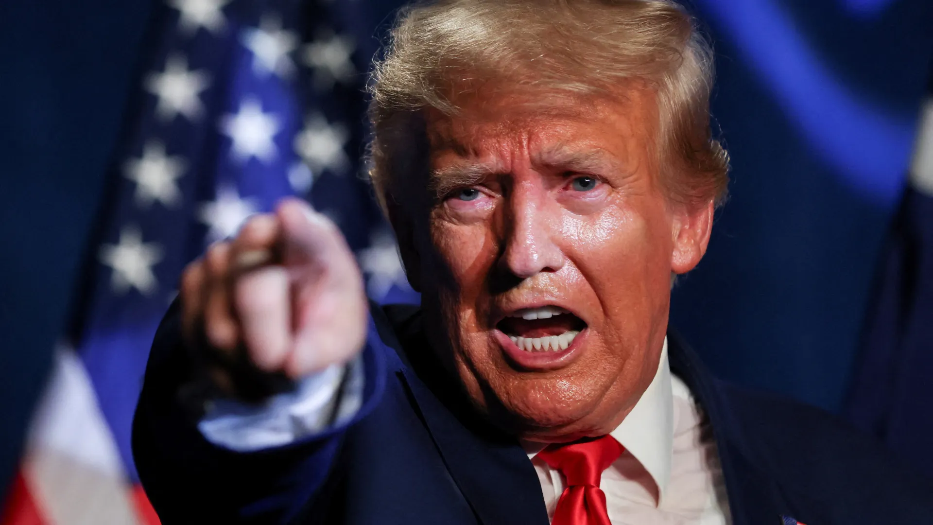
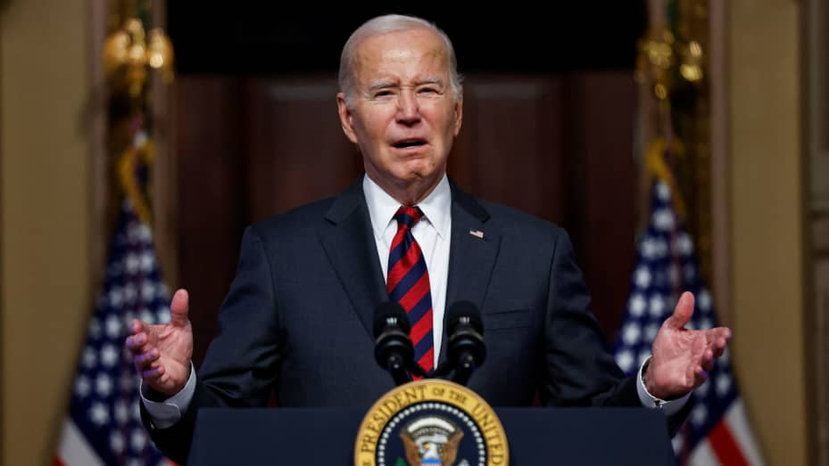
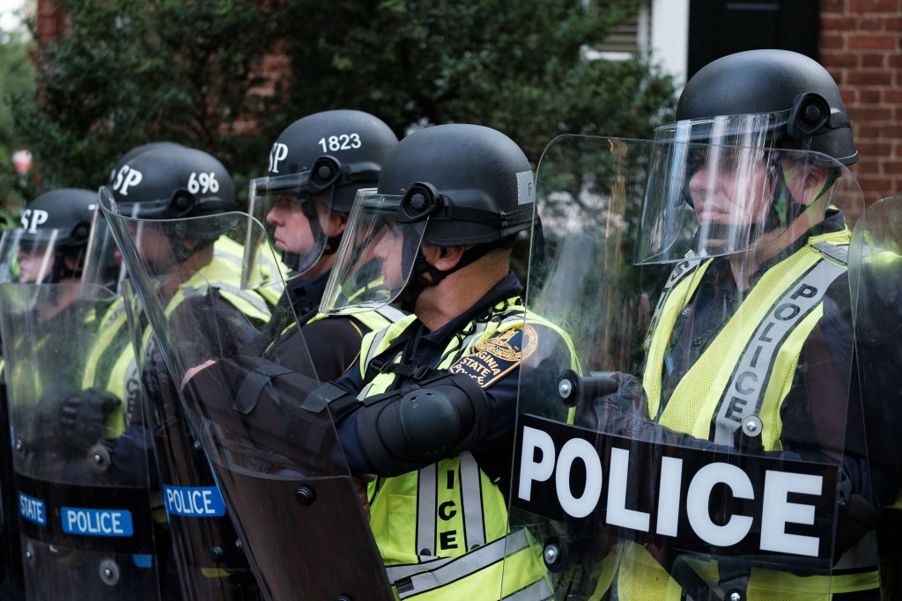
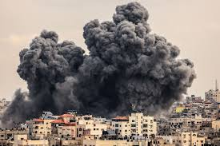
Why teach about local government?

Slide 5
Why Teach About Local Government?
Observable
Greater Individual Impact
Accessible to Students (<18 years)
Relevance and Connections to “The Big Issues”
Students Can See Real Results

Slide 6
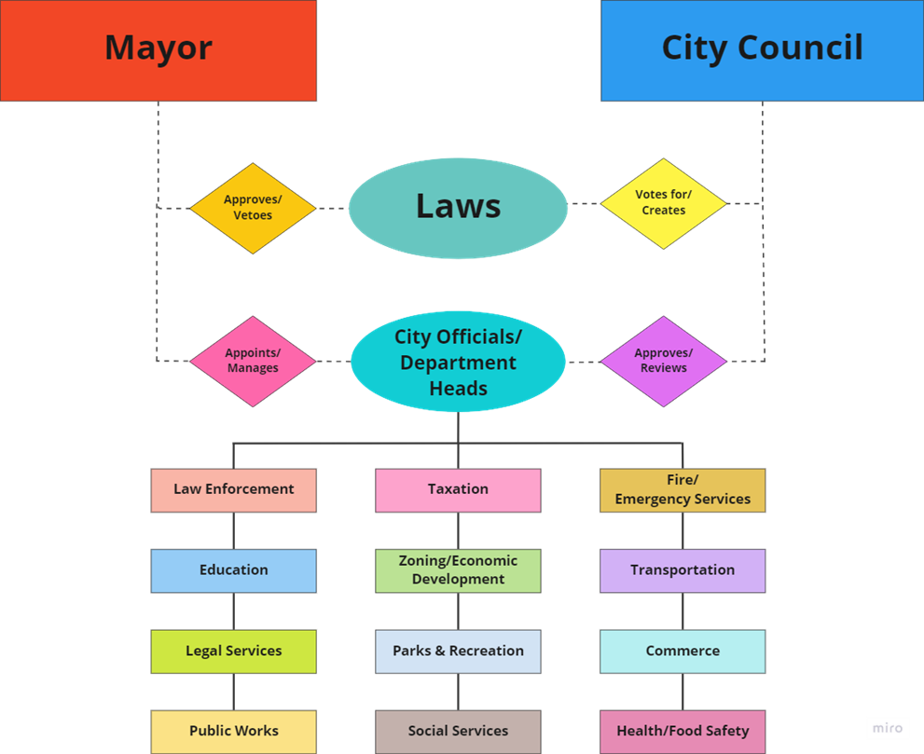
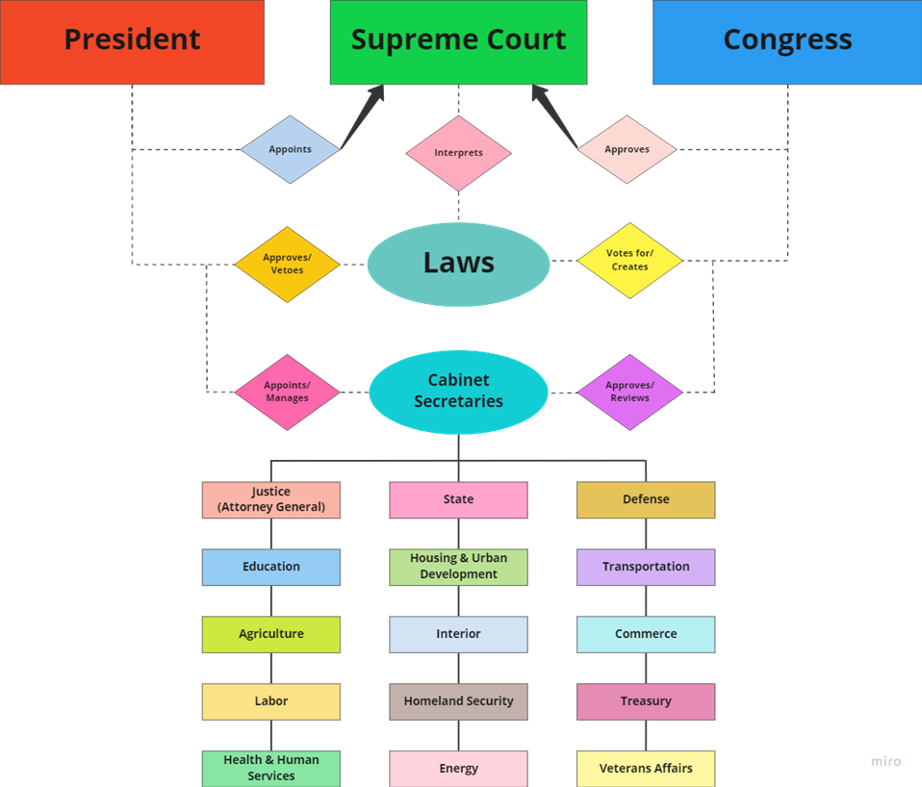
Why Teach About Local Government?

Slide 7
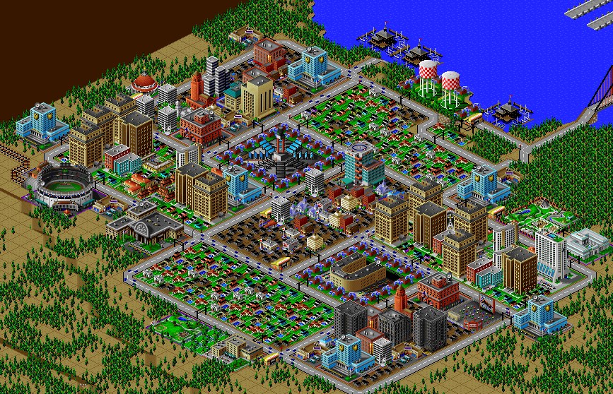
Welcome to Simu Town

Slide 8
Your Task
READ over the Responsibilities of Local Government.
Label all seven of your sticky notes with your GROUP NUMBER.
Read over your proposal and discuss which of the seven responsibilities apply to what is being proposed (there will likely be more than one).
When you have discussed your reasoning and decided as a group, place a numbered sticky note on the Local Responsibilities Chart in each of the matching categories.

Slide 9
Discussion Questions
Judging by the number of proposals, which under each responsibility of local government which seem MOST important/impactful?
Which seem LEAST important?
Do we think this reflects reality? Why/why not?

Slide 10
Discussion Questions
Are there any responsibilities listed that you feel the local government SHOULD NOT have?
Are there any additional responsibilities you feel the local government SHOULD have?

Slide 11
Discussion Questions
What advantages/disadvantages do you think there might be in having a small council of people be in charge of these responsibilities rather than one person or a much larger group?

