Slide 1
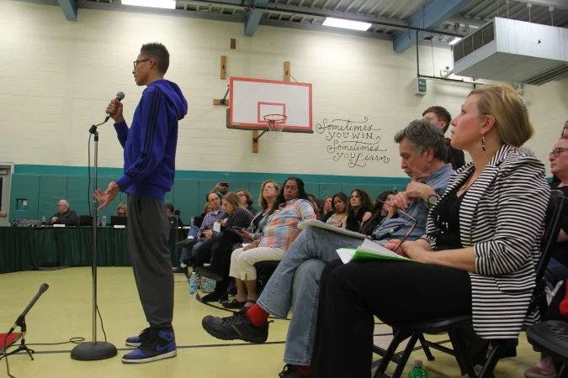
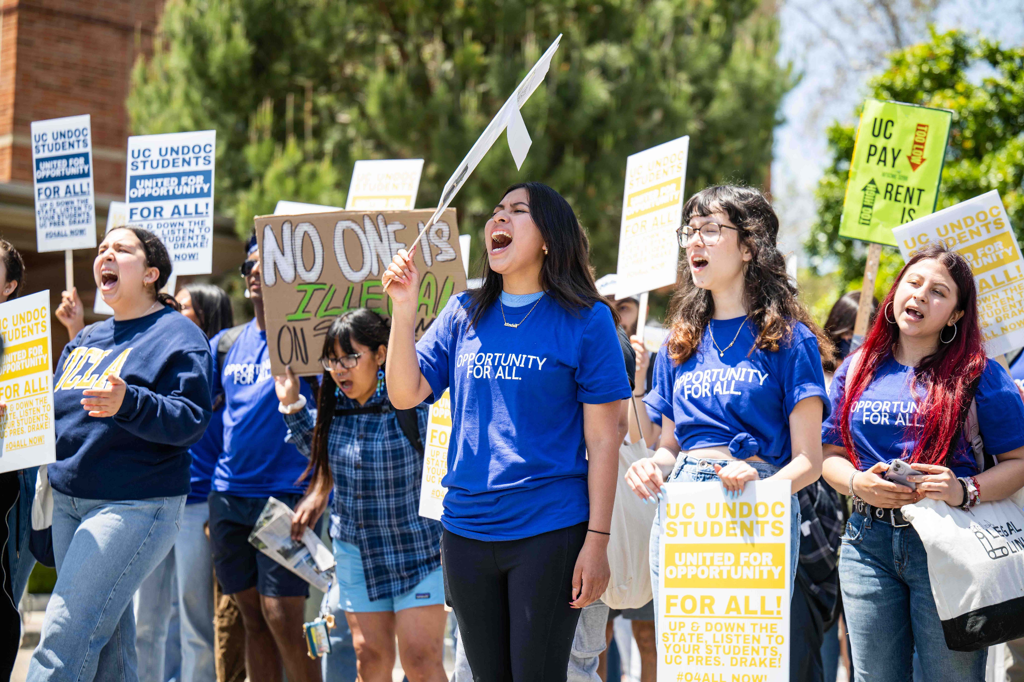
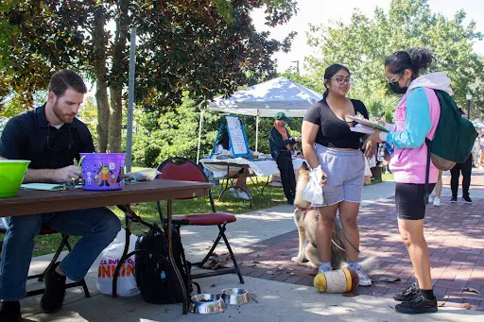
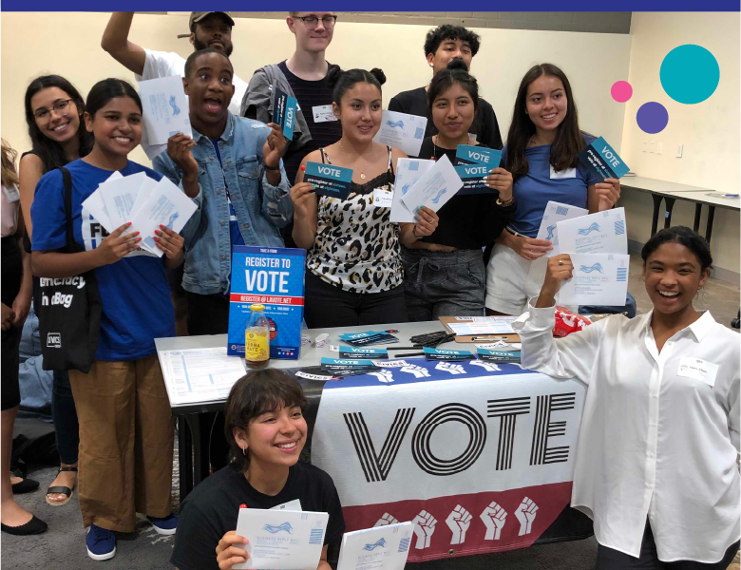
Student-Driven Civic Capstone Projects

Slide 2
Close Up Foundation
Close Up is a nonprofit, nonpartisan organization that informs, inspires, and empowers young people to be active and engaged participants in a democracy. Our approach to civic education rests on four key principles:
Issue-Centered Education
Experiential Education
Constructivism
Cooperative Learning

Slide 3
Civic Action Sequence
I. Evaluating Community Issues
II. Researching the Issue &
Identifying Solutions
III. Develop Recommended
Action Plan
IV. Presentation & Reflection

Slide 4
Framework Overview
Intended for a 2-3-week unit (10-12 class periods of 45-50 minutes)
Group-driven, 8-10 students per group/3-4 groups per class
Step-by-step progression through Evaluating Community Issues, Researching Issues and Identifying Solutions, Developing an Action Plan, Presenting and Reflection on the Project

Slide 5
Framework Components
Teachers will receive:
Lesson plans for each unit class period
All necessary lesson materials including worksheets, graphic organizers, and lesson components
Background resources, research guides, and instructional slides
Evaluation criteria and rubrics

Slide 6
Unit Sequence - Pt. 1
Evaluating Community Issues (2-3 Class Periods)
Students will analyze case study examples of student action addressing affordable housing, community policing, and gun violence
Working in project groups, students will conduct a Root Cause Analysis on the issues which impact their own communities
Collaboratively, students will select an issue and a specific root cause or symptom of that issue to be the focus of their Civic Capstone Project

Slide 7
Unit Sequence - Pt. 2
Researching the Issue & Identifying Solutions (3 Class Periods)
Students will research the impact of their civic issue on their community using a primary and secondary sources guide
Students will identify the effects of the issue and real-world examples, explore the history of the issue in the community, and examine past and contemporary efforts to address the issue
Students will determine the effectiveness of these efforts and develop a solution which either expands on them or presents a novel approach

Slide 8
Unit Sequence - Pt. 3
Develop a Recommended Action Plan (3 Class Periods)
Students will will determine which groups are best positioned to effectively implement their solution (peers, community members, school officials, decision-makers, state government, etc.)
Students will explain what action(s) should be taken by which groups, why they have recommended those actions, and suggest how the target group(s) can implement the solution

Slide 9
Unit Sequence - Pt. 4
Presentation & Reflection (2-3 Class Periods)
Based on the rubric criteria, students will present their research and action plan in a format of their choosing including poster presentations, slideshows, and videos
Students will reflect on the process of developing their action plan and what real-world action they could take to impact their focus issue

